Slide 1


KLS's Gogte Institute of Technology
Department of Computer Science & Engineering
Course Name: Block Chain Management
Course Code: 18CS743
Unit II : Blockchain Basics
Assistant Professor,
Ravi U. Kalkundri

Slide 2
Grasping Blockchain Fundamentals

Slide 3
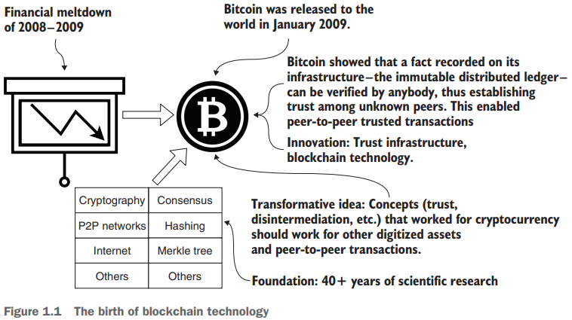
Tracing Blockchain’s Origin
Even though Bitcoin appeared to have launched suddenly in 2009, the idea of a working digital currency has been a quest since the dawn of computing.
Bitcoin’s blockchain technology stands on a strong foundation of more than 40 years of scientific research in cryptography, hashing, peer-to-peer networks, and consensus protocols.
Figure 1.1 provides a brief history of blockchain, its innovation and robust scientific foundation, and its transformative effect on modern networked systems.

Slide 4
1.1 From Bitcoin to blockchain
The initial excitement about blockchain technology was about enabling peer-to-peer transfers of digital currency to anybody in the world, crossing human-created boundaries (such as the borders of countries) without any intermediaries such as banks.
DEFINITION: “A transaction recorded on a blockchain contains a peer-to-peer message that specifies the operations executed, data parameters used for the execution of operations, the sender and receiver of the message, the transaction fee, and the timestamp of its recording”.

Slide 5
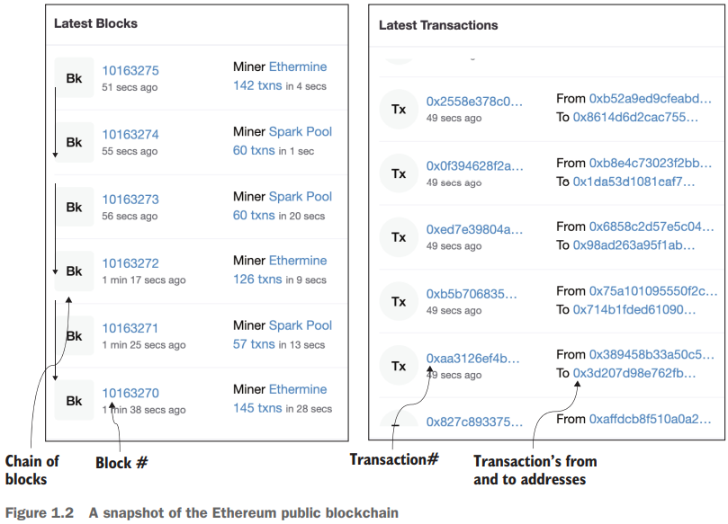
1.1 From Bitcoin to blockchain
Ethereum is a decentralized, open-source blockchain with smart contract functionality. Ether is the native cryptocurrency of the platform.
Ethereum is a technology that's home to digital money, global payments, and applications.
Figure 1.2 also shows blocks of Txs. Each block (Bk) is made up of a set of transactions and is identified by a block number. Block #10163275 has 142 Txs, and block #10163274 has 60 Txs. You may see a different set of blocks when you visit the site.

Slide 6
1.2 What is blockchain?
A blockchain is a technology for enabling trust in a decentralized system of transacting peer participants.
The purpose of a blockchain is to verify and validate (or reject, if not valid) a transaction initiated by a participant, and then execute the transaction and record the proof of these actions with the consensus of the peer participants.

Slide 7
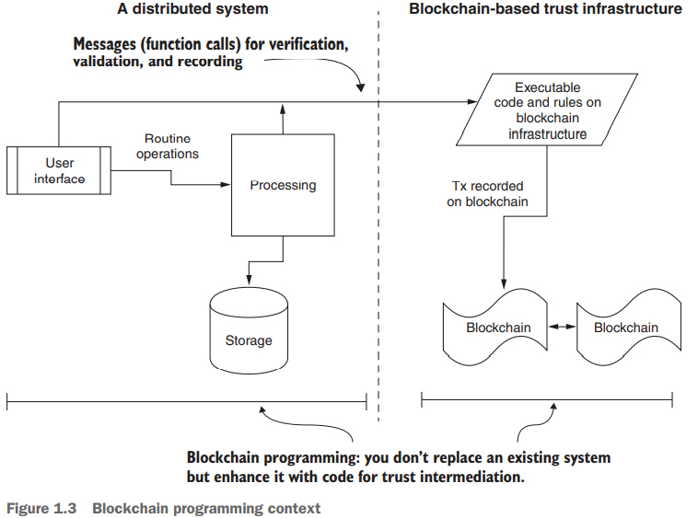
1.2 What is blockchain?
As shown in figure 1.3, the blockchain-based trust infrastructure exists within a larger system.

Slide 8
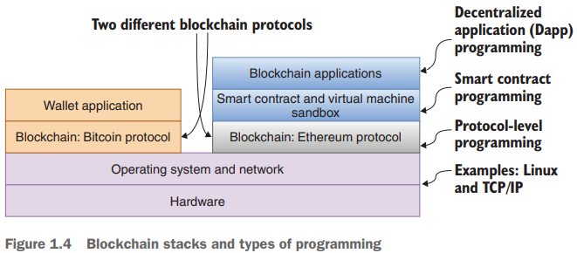
1.2 What is blockchain?
A blockchain is a technology for enabling trust in a decentralized system of transacting peer participants.
To help you further understand blockchain programming, let’s examine the blockchain stacks for Bitcoin and Ethereum, shown in figure 1.4.
These stacks represent the two models of blockchain in its short history.
Bitcoin has only the wallet application, whereas Ethereum features programmable code called smart contracts

Slide 9
1.2 What is blockchain?
Figure 1.4 also shows the three levels of programming:
Protocol-level programming—This level involves software that is needed for the deployment and operation of the blockchain itself. This software is similar to your operating system or networking software.
Smart contract-level programming—One level above is smart contract (or rules engine) programming, where you design and program the rules for verification and validation, and specify the data and messages that are to be recorded on the underlying blockchain. The smart contract is the engine that drives the blockchain on behalf of the user application.
Application-level programming—This level involves programming using web (or enterprise or mobile) application frameworks and user interface design concepts that are outside the blockchain protocol.

Slide 10
1.2 What is blockchain?
DEFINITION: “Dapps are web or enterprise applications that include application logic to invoke blockchain functions that implement trust intermediation”.
Dapps embed a significant code element—that of smart contracts. For any given smart contract, an exact copy of the smart contract’s code is transmitted through a special transaction and deployed in the participant nodes of a blockchain network.
DEFINITION : “A smart contract is an immutable executable code representing the logic of a Dapp”.
The data variables and functions defined in a smart contract collectively represent the state and operations for enforcing an application’s (Dapp’s) rules for verification, validation, and recording on the blockchain.

Slide 11
1.3 Blockchain Programming
Four fundamental concepts play a significant role in making blockchain programming different, the four key roles fulfilled by a blockchain are:
Decentralized infrastructure
Distributed ledger technology
Disintermediation protocol
Trust enabler

Slide 12
1.3 Blockchain Programming
1. Decentralized infrastructure
Special computing hardware and software stacks support the blockchain protocol, smart contracts, and applications.
What is a decentralized system?
Participants communicate peer to peer.
Participants are in control of their assets, digital or otherwise (such as an audio file, a digital health record, or a piece of land).
Participants can join and leave the system as they wish.
Participants operate beyond the typical boundaries of trust (such as within a university or a country).
Decisions are made by the distributed participants, not by any central authority.
Intermediation is achieved by the use of automated software such as a blockchain

Slide 13
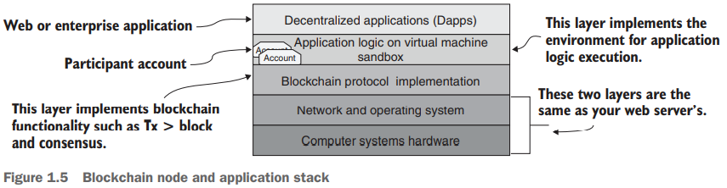
1.3 Blockchain Programming
1. Decentralized infrastructure
BLOCKCHAIN NODES, NETWORKS, AND APPLICATIONS
Consider air traffic. Flights have origins and destinations, and stopover airports and waypoints form the airline networks. Similarly, blockchain nodes host the computational environment that serves as endpoints of transactions and also performs other functions, such as relaying and broadcasting transactions.

Slide 14
1.3 Blockchain Programming
1. Decentralized infrastructure
A blockchain application is not a single-user application.
It typically connects a large number of participants through its network of nodes.
Each node can host multiple accounts to identify the different customers it services. A node can also host more than one Dapp, such as one for a decentralized supply chain management system and another for a decentralized payment system.

Slide 15
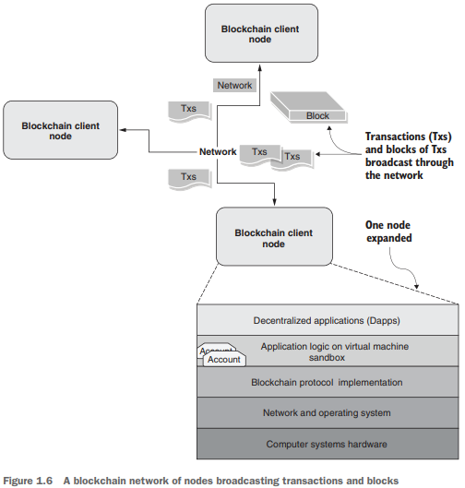
1.3 Blockchain Programming
1. Decentralized infrastructure
Figure 1.6 shows a network of three nodes connected by a network. The network facilitates broadcast of the
transactions initiated by users
blocks formed out of the transactions

Slide 16
1.3 Blockchain Programming
1. Decentralized infrastructure
The smart contracts are deployed in a sandbox environment such as a virtual machine (VM) hosted by a blockchain node.
The syntax of a smart contract is similar to a class in an OO (object-oriented) language, contains data, functions, and rules for the execution of functions.
Calling or invoking a smart contract function generates the transactions that are recorded on the blockchain, as shown in figure 1.7.
If any of the verification and validation rules fails, the function invocation is reverted.
But if the execution is successful, the generated transactions (Txs) are broadcast to the network for recording, as shown in figure 1.7.

Slide 17
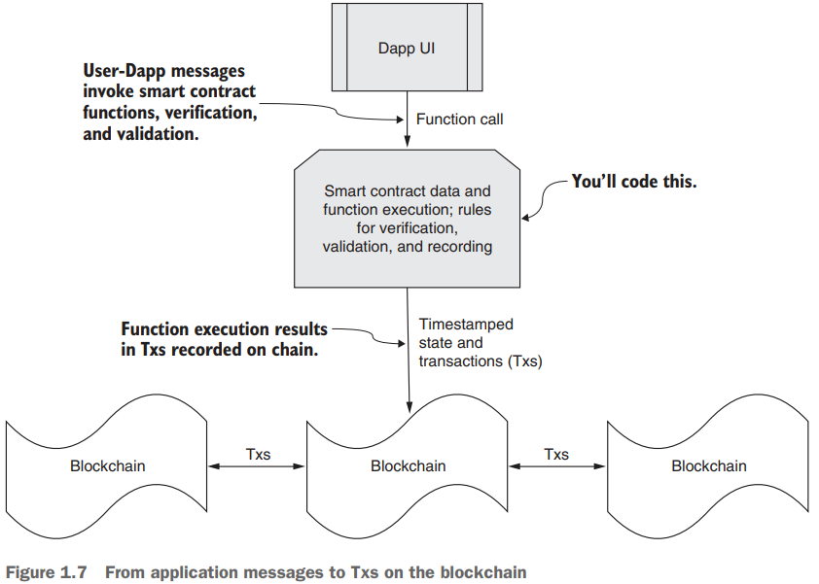
1.3 Blockchain Programming
1. Decentralized infrastructure
The figure illustrates how a function call is transformed into actions that are recorded on the blockchain.

Slide 18
1.3 Blockchain Programming
2. Distributed ledger technology
Distributed Ledger Technology (DLT) explores:
What constitutes the blockchain DLT?
The physical structure of the DLT for recording blocks of transactions
The operational details of how an application gets to use the DLT for its intended purpose: verification, validation, and immutable recording for enabling trust
The consensus algorithm (at a high level) for the integrity of the DLT

Slide 19
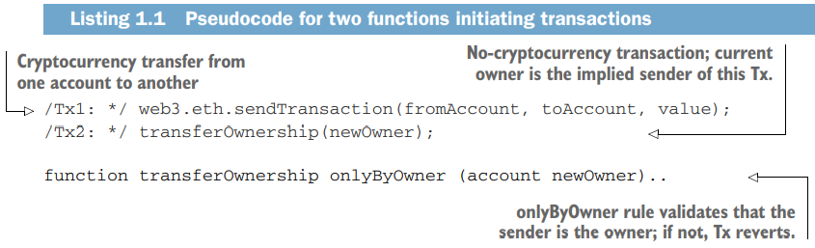
1.3 Blockchain Programming
2. Distributed ledger technology
TRANSACTIONS, BLOCKS, AND CHAIN OF BLOCKS
Applications initiate transactions and the execution of smart contract code.
A simple cryptocurrency transfer between accounts, for example, generates a “send” transaction.
Listing 1.1 shows an example pseudocode for function calls for initiating two types of transactions.
Tx1 is for the transfer of cryptocurrency.
Tx2 is an application-specific transfer of ownership of an asset from one owner to another, probably to fulfill the sale of an asset.

Slide 20
1.3 Blockchain Programming
2. Distributed ledger technology
Now that you know how transactions are generated and broadcast on a network, let’s explore how they get recorded on the blockchain.
A set of transactions makes a block, and a set of blocks make a blockchain, as shown in figure 1.8.

Slide 21
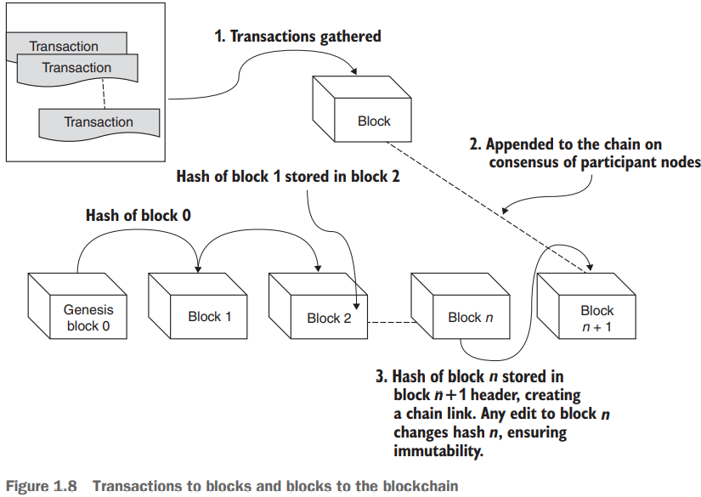
1.3 Blockchain Programming
2. Distributed Ledger Technology
The process is as follows:
Transactions on the network are verified, gathered, and pooled. Nodes select a set of transactions from the pool to create a block.
Participant nodes use a consensus algorithm to collectively agree or come to a consensus on a single consistent block of transactions to be appended to the existing chain.
A hash or representative value of the current lead block of the chain is added to the newly appended block, creating a chain link.
Distributed→ because the blockchain protocol ensures that every distributed node involved has an identical copy of the chain of blocks.
Immutable→ because each newly created block is linked to the existing blockchain by the hash value of the current head of the blockchain

Slide 22
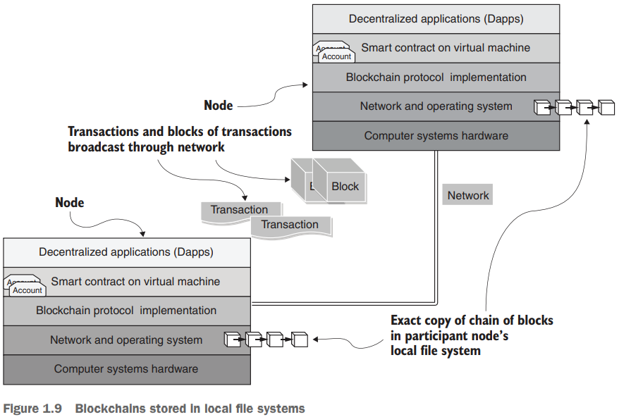
1.3 Blockchain Programming
2. Distributed ledger technology
Blockchain Stored in Local File System
The blocks of a blockchain are stored in the local file systems of the participant nodes, as shown in figure 1.9.
The chain of blocks on each node is the distributed ledger recording Txs and related data in its blocks.
Figure 1.9 depicts the fact that every node has an exact copy of the blockchain.

Slide 23
1.3 Blockchain Programming
3. Disintermediation protocol
Like any transportation infrastructure, a blockchain infrastructure has rules that you need to follow.
A blockchain protocol defines the following, among other things:
The structure of a blockchain (transactions, blocks, and chain of blocks)
Fundamental algorithms and standards for encryption, hashing, and state management
Methods for implementing consensus and a consistent chain of blocks
Techniques for handling exceptions resulting in an inconsistent ledger
The execution environment for code on the blockchain and rules for maintaining consistency, correctness, and immutability in this context

Slide 24
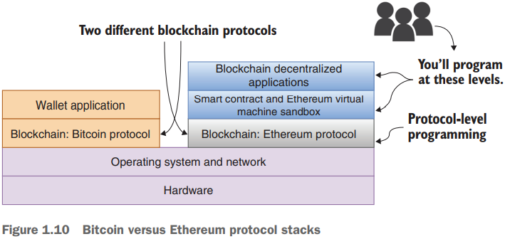
1.3 Blockchain Programming
3. Disintermediation protocol
Bitcoin VS Ethereum Protocol Stack
The Bitcoin blockchain is for the transfer of cryptocurrency, and it does that job well. It has only wallet applications for initiating transactions.
Ethereum supports smart contracts and a VM sandbox called Ethereum VM (EVM) on which the smart contracts execute. Smart contracts in turn enable decentralized operation of applications.

Slide 25
1.3 Blockchain Programming
4. Trust enabler
Nw that you know how transactions are generated and broadcast on a network, let’s explore how they get recorded on the blockchain.
Trust is critical for business and personal transactions, whether those transactions are trade, commerce, legal, medical, marital, interpersonal, or financial. Imagine a business transaction for transferring a million dollars. You have a secure channel for transfer, but are you sure you can trust the parties involved?
The three Ds— collectively enable trust in a system:
Decentralized infrastructure,
Distributed ledger technology, and
Disintermediation protocol

Slide 26
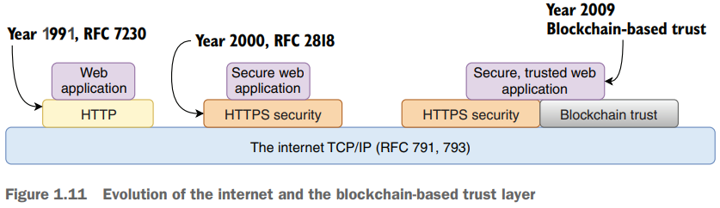
1.3 Blockchain Programming
4. Trust enabler
Figure 1.11 shows the evolution of the protocols leading to blockchain-based trust, which has yet to become a standard in the internet context.

Slide 27
Thank You

